Slide 1

Myers-Briggs Personality Predictor
Made by:-Chanakya, ANCHAL KUMARI, SHAKTI NANDAN

Slide 2
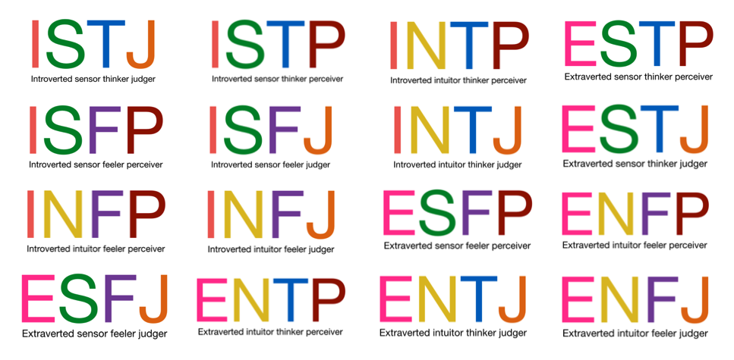

Slide 3
Aim:
It’s aim is to provide insight into a person’s personality traits, behaviours, and potential career paths, as well as to improve self-awareness and communication skills.

Slide 4
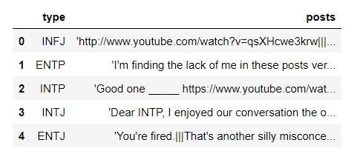
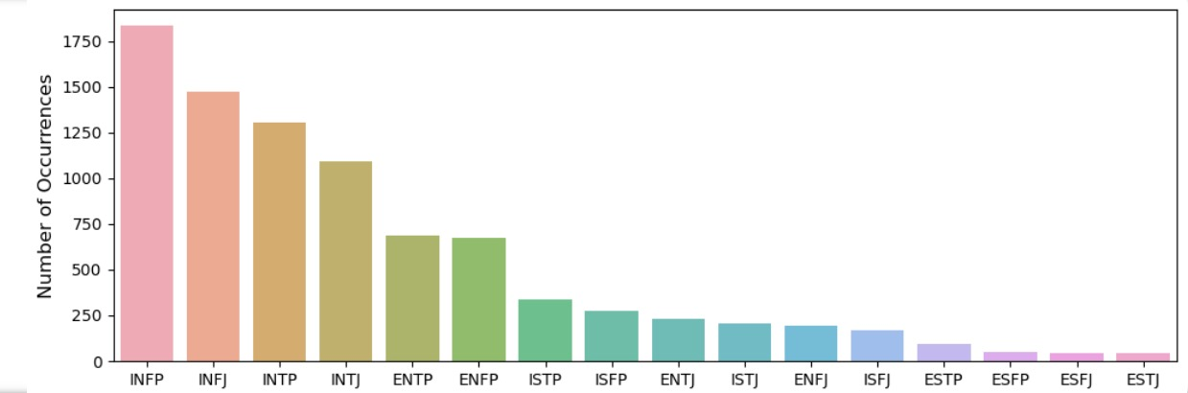
Data
The data set contains 8,676 observations (people) where each observation gives a person’s Myers-Briggs personality type as a 4-letter code.

Slide 5
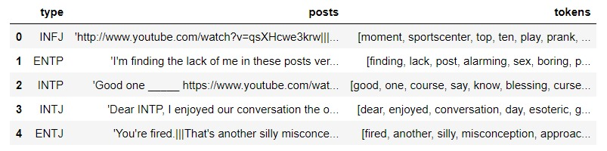
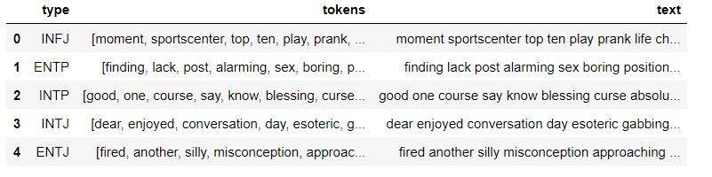
Cleaning and Tokenization
1.Removed:
a. Stopwords
b. Punctuation
c. Personality types from the post
2.Lower the words
3.WordNetLwmmitizer
4.Tokenized
Joined tokens to make a continuous text.

Slide 6
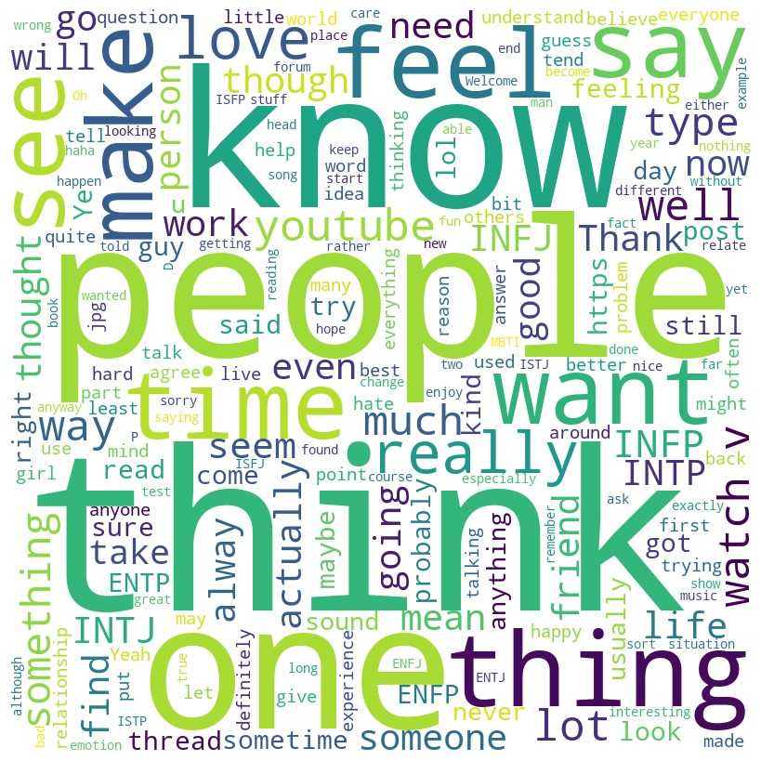
Word Clouds

Slide 7
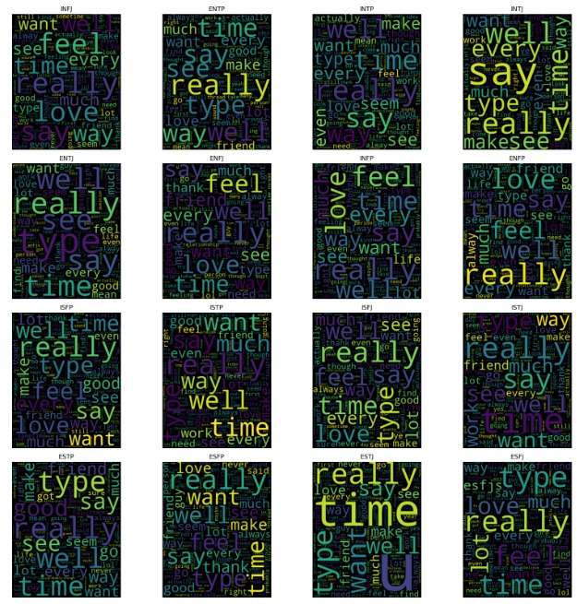

Slide 8
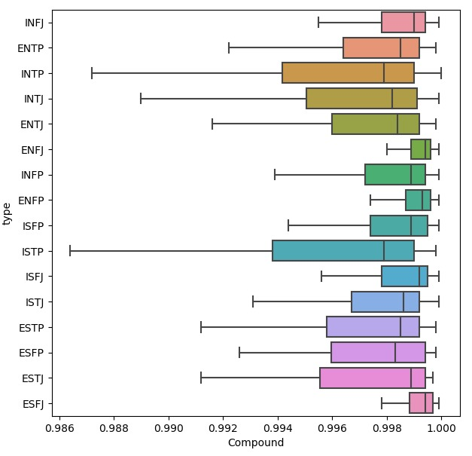
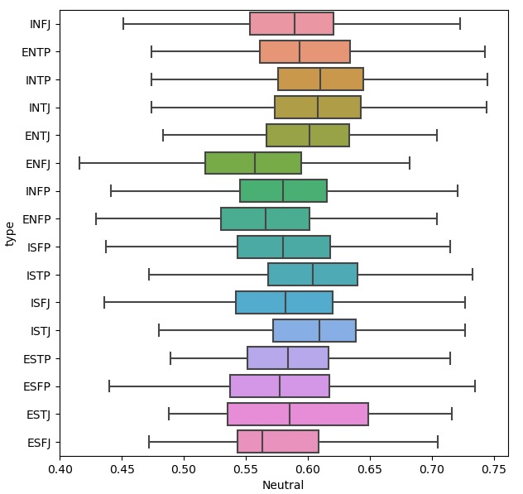
Sentiment Analysis

Slide 9
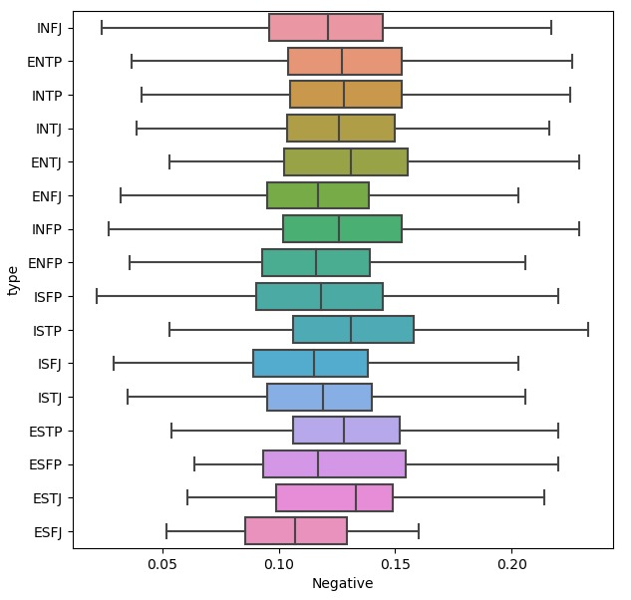
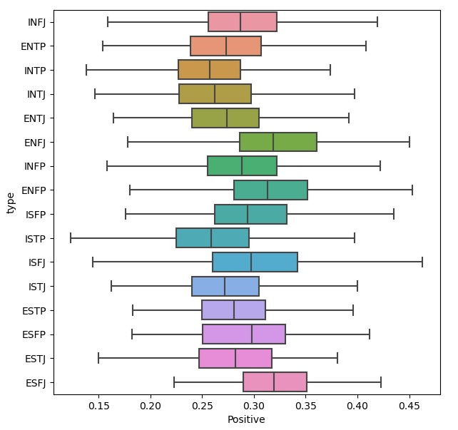

Slide 10
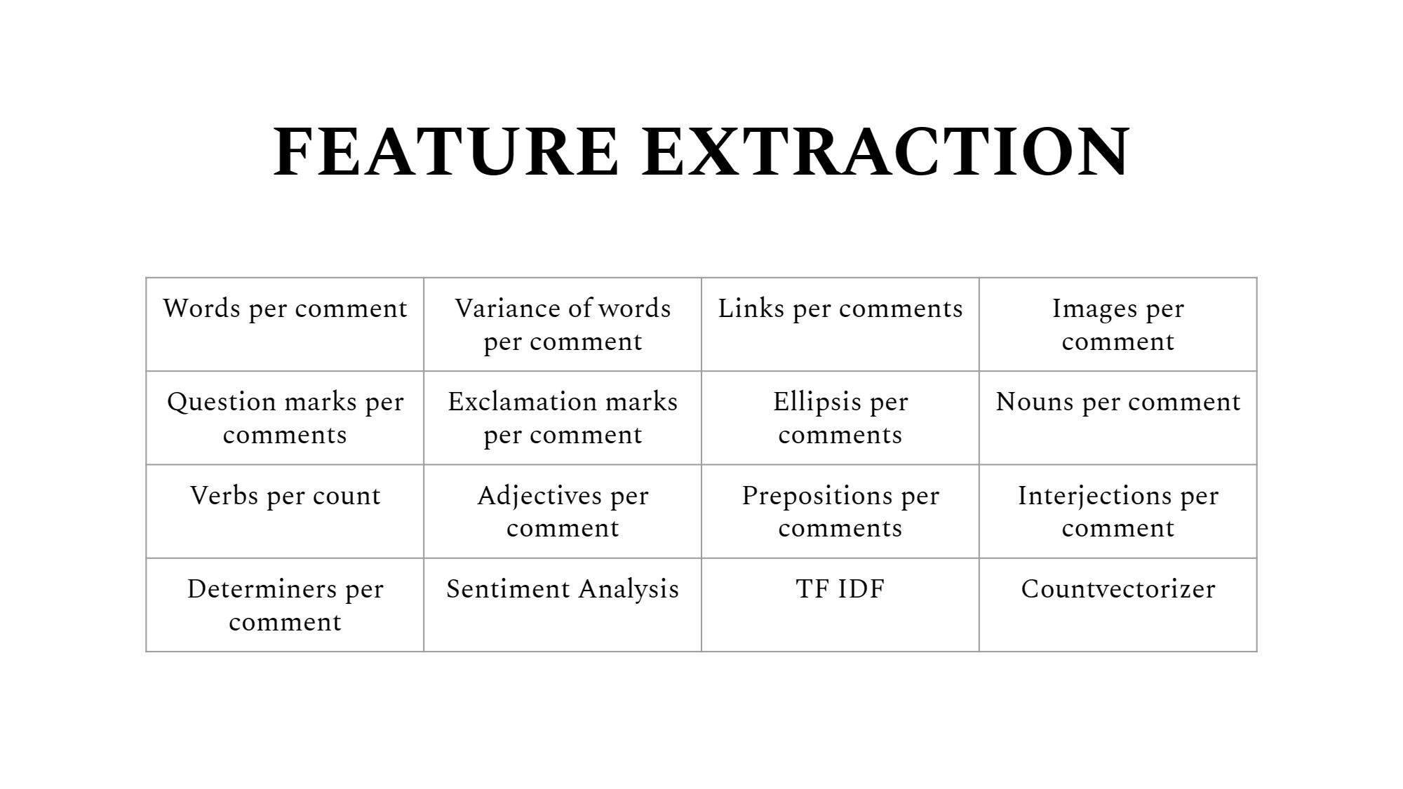

Slide 11
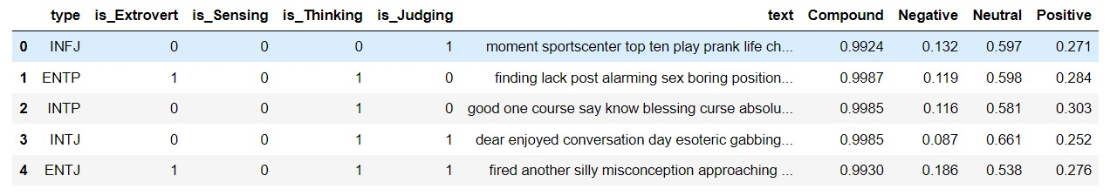
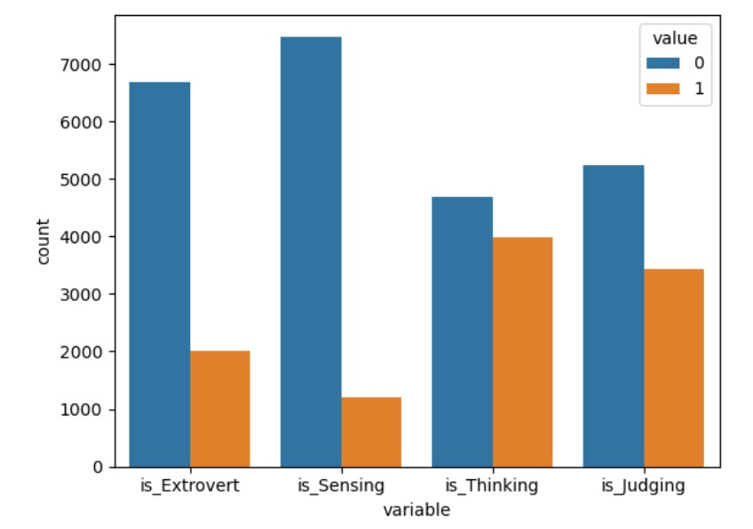
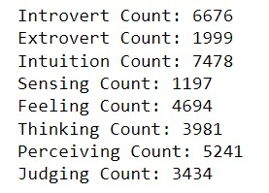
Target Variables

Slide 12
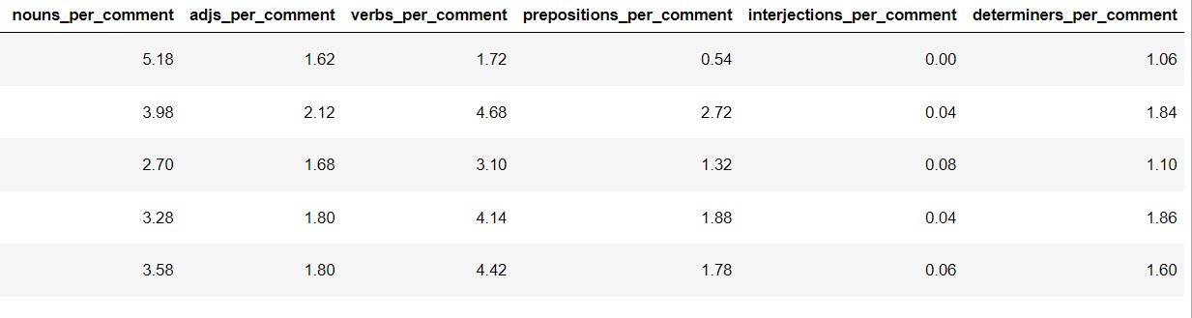
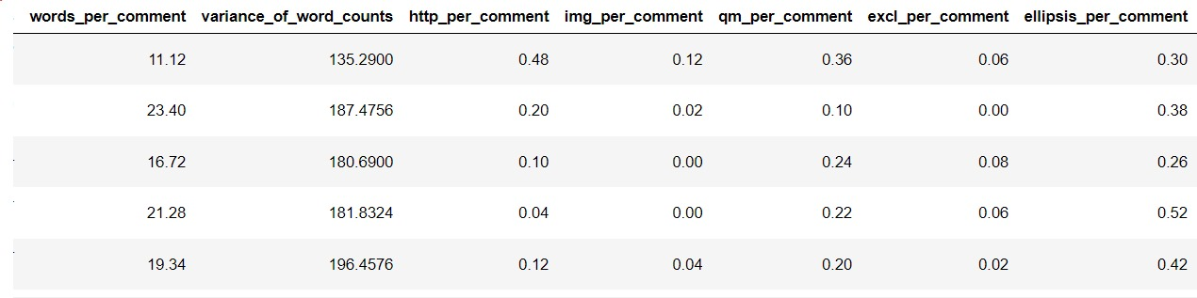
Parts of Speech

Slide 13
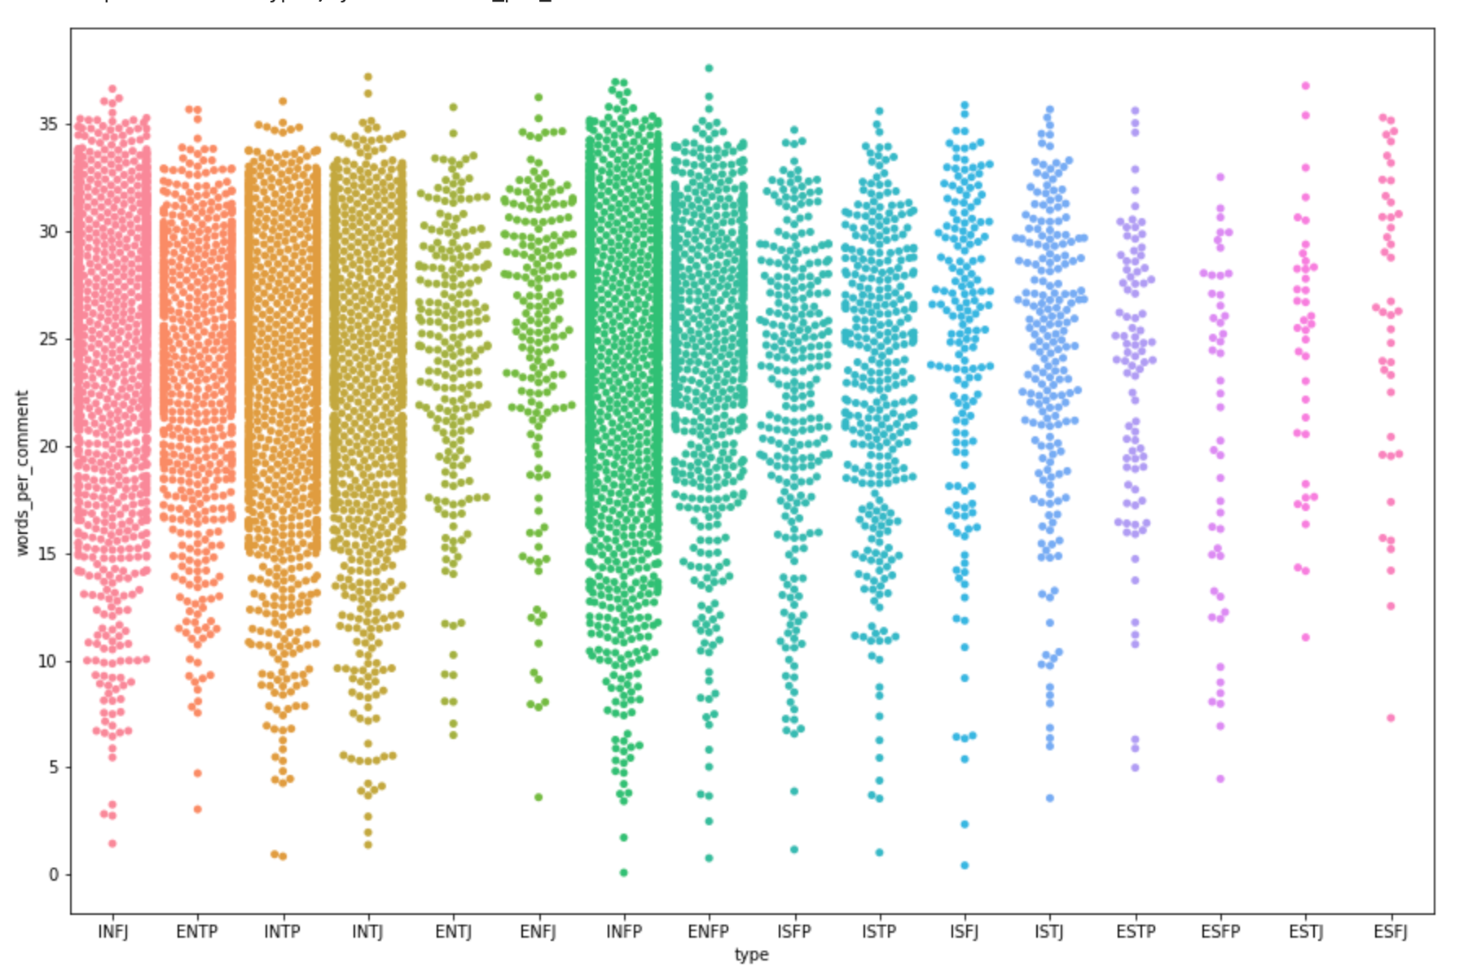
Data Imbalance

Slide 14
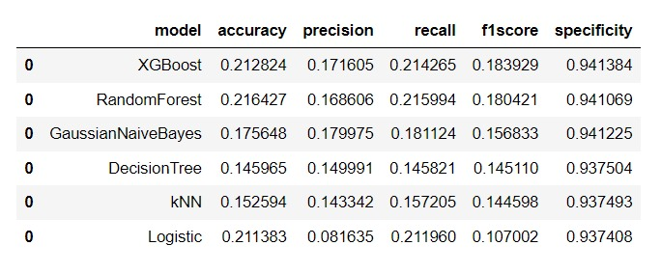
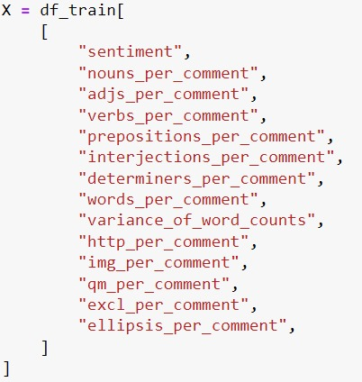
Feature Importance
● Ran a couple models with the extracted features to be able to see which model does best.
● This was sorted based on f1 score which gives accuracy and precision equal importance.
● Here XG Boost did the best
● This model was used to extract the most important features
Y = is_Extrovert, is_Sensing, is_Thinking, is_Judging

Slide 15
XG Boost
● XG Boost was used to see the importance of each feature for that particular characteristic.
● All of the characteristics except Thinking vs Feeling shows that sentiments are very important
● All of them have the same top three features
● Data was divided in training and testing data set based for each personality type.
● XGBClassifier() was used to extract the most important feature

Slide 16
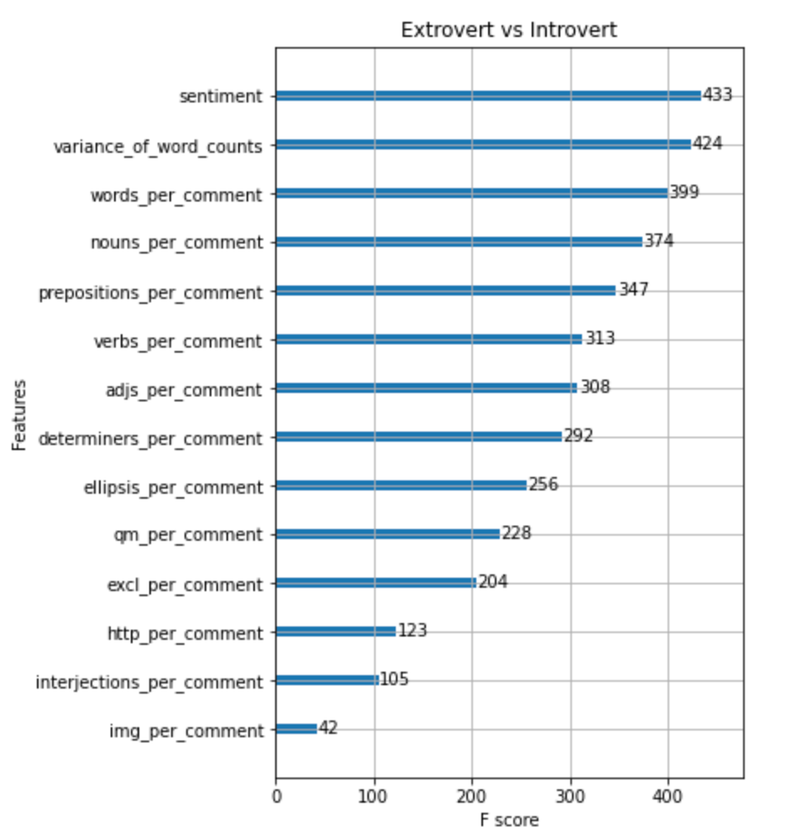
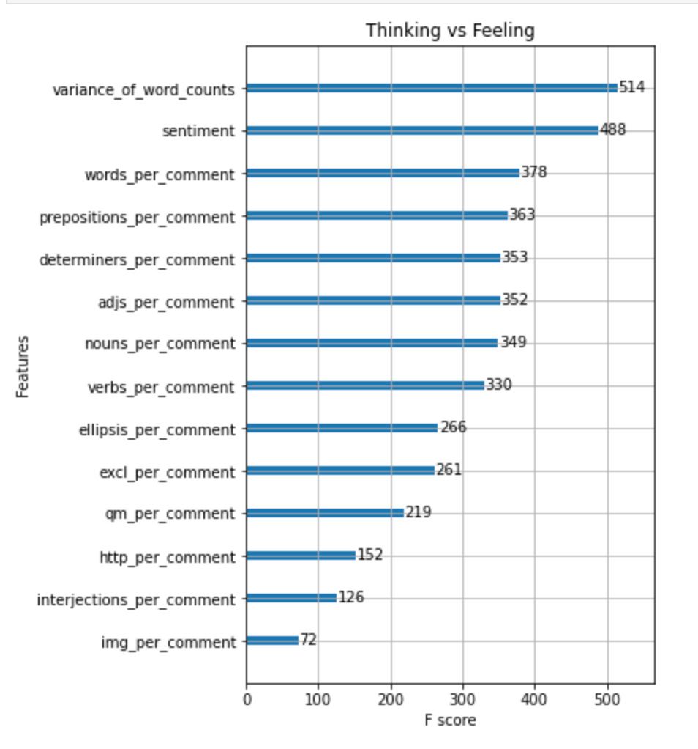
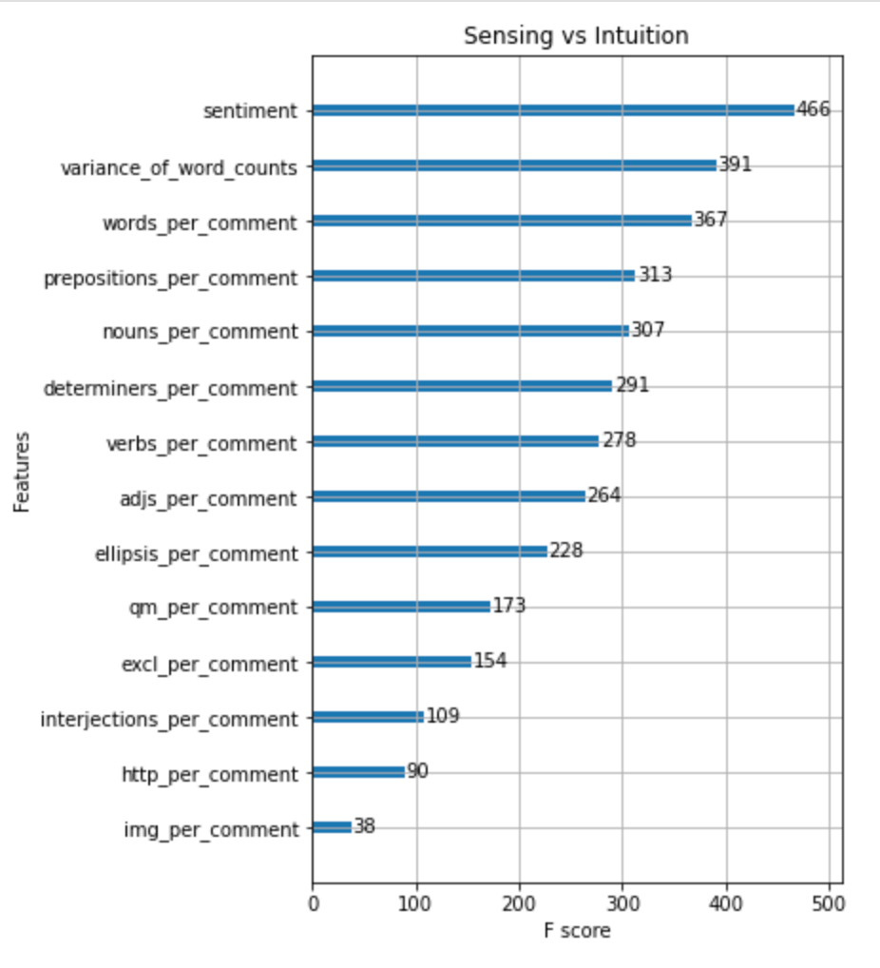

Slide 17
Machine Learning Models

Slide 18
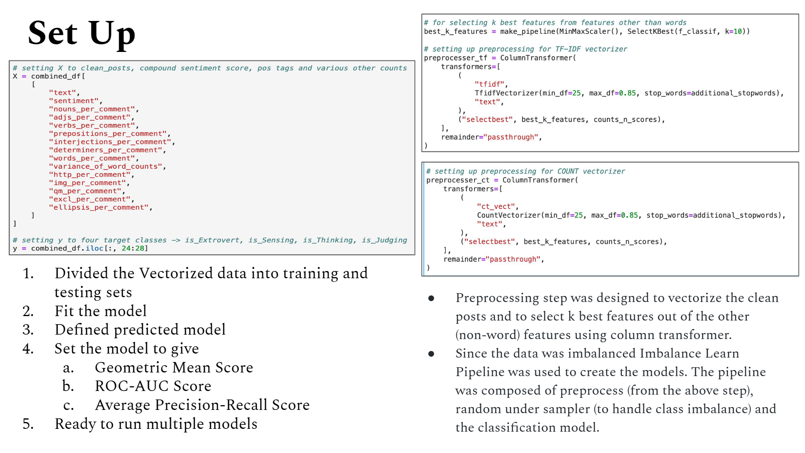
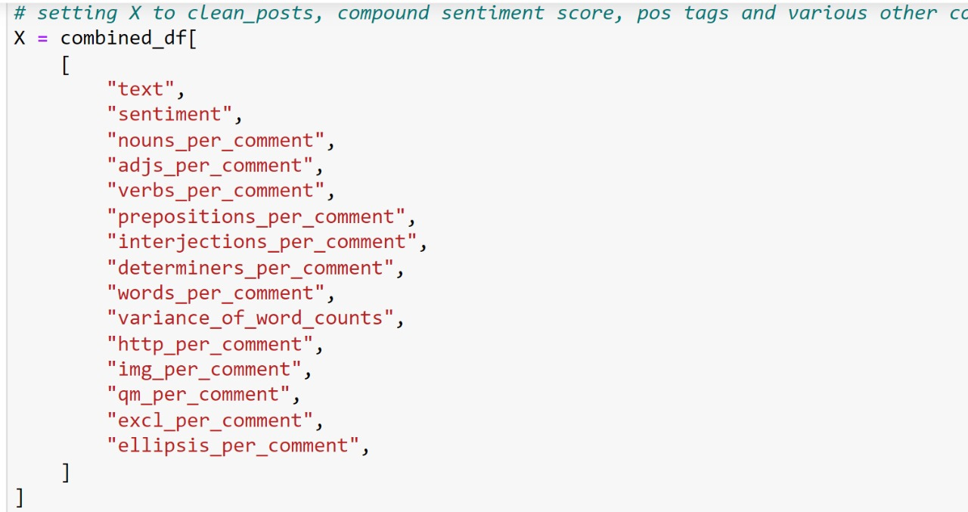
Set Up

Slide 19
1.TF-IDF Logistic Regression 2. Count Vectorized Logistic Regression 3. TF-IDF Logistic Lasso 4. Count Vectorized Logistic Lasso 5. TF-IDF Logistic Ridge 6. Count Vectorized Logistic Ridge 7. TF-IDF Support Vector Classifier 8. Count Vectorized Support Vector Classifier 9. TF-IDF Naive Bayes 10. Count Vectorized Naive Bayes 11. TF-IDF Random Forest 12. Count Vectorized Random Fores

